Slide 1
COLOR APPLICATIONS WORKSHOP
2018+ WORLD COLORS
REPORT BACK
Your Workshop # : 2018+ World Colors #2
Workshop Facilitator: Leslie Jee
Workshop Co-Facilitator: Jessica Youde
Workshop Participants and Company names:
Dixon Bartlett, Norwalk Furniture
Richard Capel, Capel Rugs
Monique Gardere, Manufacture Nationale de Peinture
Karin Jeske, Tesselle/StyleData
Tracey Lachapelle-Deasy, Plastics Color Corp
April Tetlow, Chromaflo Technologies

Slide 2
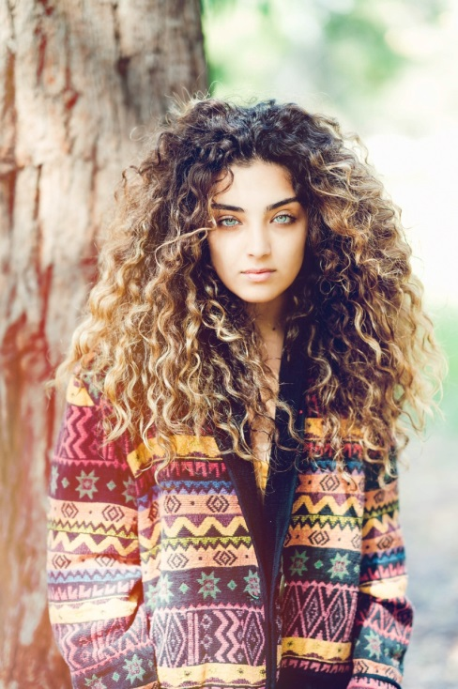
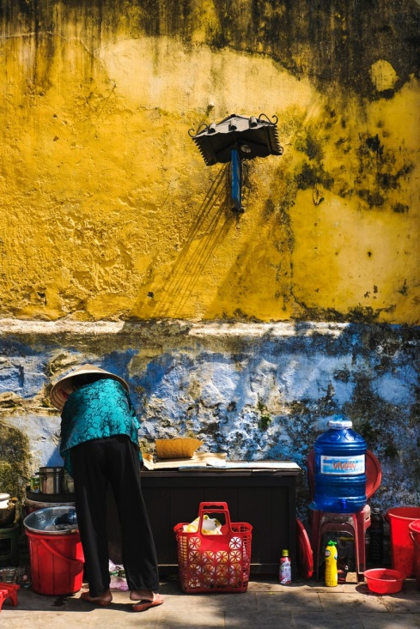
1
COLOR APPLICATIONS WORKSHOP
2018+ WORLD COLORS
2018+ Trend Story #1: Global Alchemy
Global Alchemy is a mix of adventure and exotic appeal. The current trend adapts traditional motifs from varying cultures and allows for the creation of unique combinations, not limited to one ethnicity or style. It incorporates the use of lustrous, metallic finishes in almost every shade of gold, including deeper burnished gold to pink gold and copper. These rich tones read as lux and expensive.
Photos from Unsplash.com

Slide 3
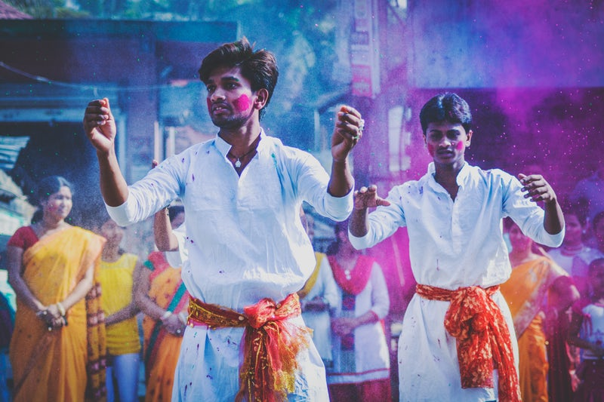
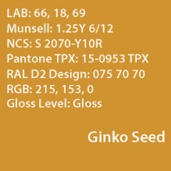
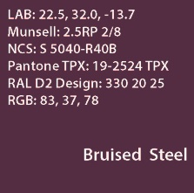
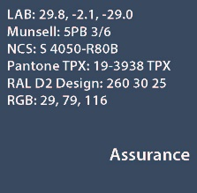
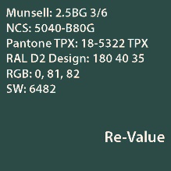
1
COLOR APPLICATIONS WORKSHOP
2018+ WORLD COLORS
Photo from Unsplash.com
How is this story affecting color in your industry?
It affects color as traditional motifs are rich, saturated tones that also have a calming and grounding effect. Metallic finishes, especially copper, has made an impact in kitchen and bath finishes.
What other markets /industries /segments are supporting these colors?
Fashion, Home Accessories, Outdoor, Automotive, Packaging, and Roofing.

Slide 4
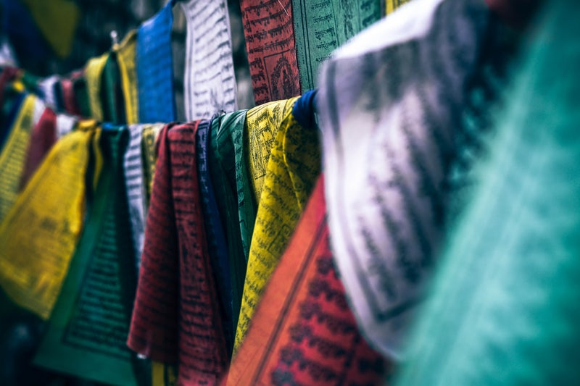
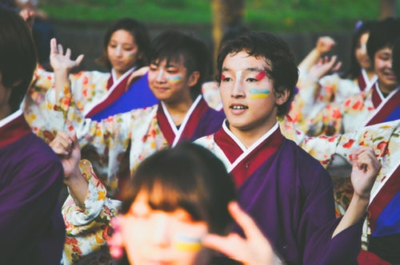
1
COLOR APPLICATIONS WORKSHOP
2018+ WORLD COLORS
Tribal and ethnic patterns and colors seem to be of interest as it piques our curiosity. The colors feel universal as they are reminiscent of colors found in nature. They are saturated, vegetable dye colors, and gemstone/mineral colors.
There are ethnic distinctions, but still bound by the same color palette. They are core colors we see repeating throughout different cultures, so they universally feel traditional to us…and there is a sense of security in that.
Photos from Unsplash.com

Slide 5
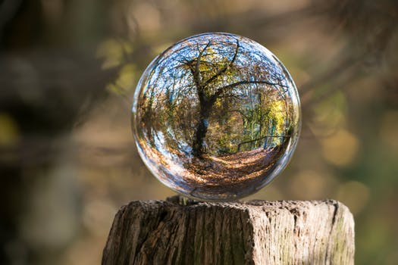
2
COLOR APPLICATIONS WORKSHOP
2018+ WORLD COLORS
2018+ Trend Story #1: Serenity
Nonstop connectivity of news and social media is spurring the desire to carve out space for personal serenity. Peaceful surroundings and less physical clutter helps to clear the mind and nourish the soul. Softer colors are soothing, but not necessarily being rendered in a juvenile way. Complex, softer color tones are tinged with a gray to exude lightness with a calming sense of stability.
Photos from Pexels.com

Slide 6
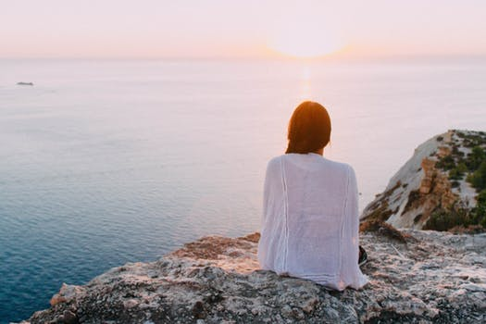
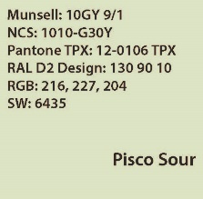
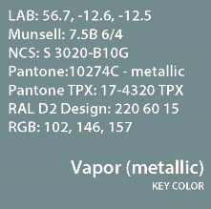
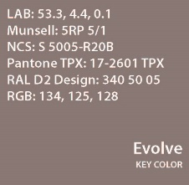
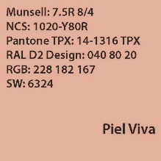
2
COLOR APPLICATIONS WORKSHOP
2018+ WORLD COLORS
Photo from Pexels.com
How is this story affecting color in your industry?
These soft tones pair beautifully with deep burnished gold tones and traditional wood finishes. They are greyed tones which give it a more sophisticated feel. The colors are rendered with softer textures, not high gloss. Soft tactile surfaces feel in sync with the trend.
What other markets /industries /segments are supporting these colors?
Fashion, Home Accessories, Outdoor, and Contract.

Slide 7
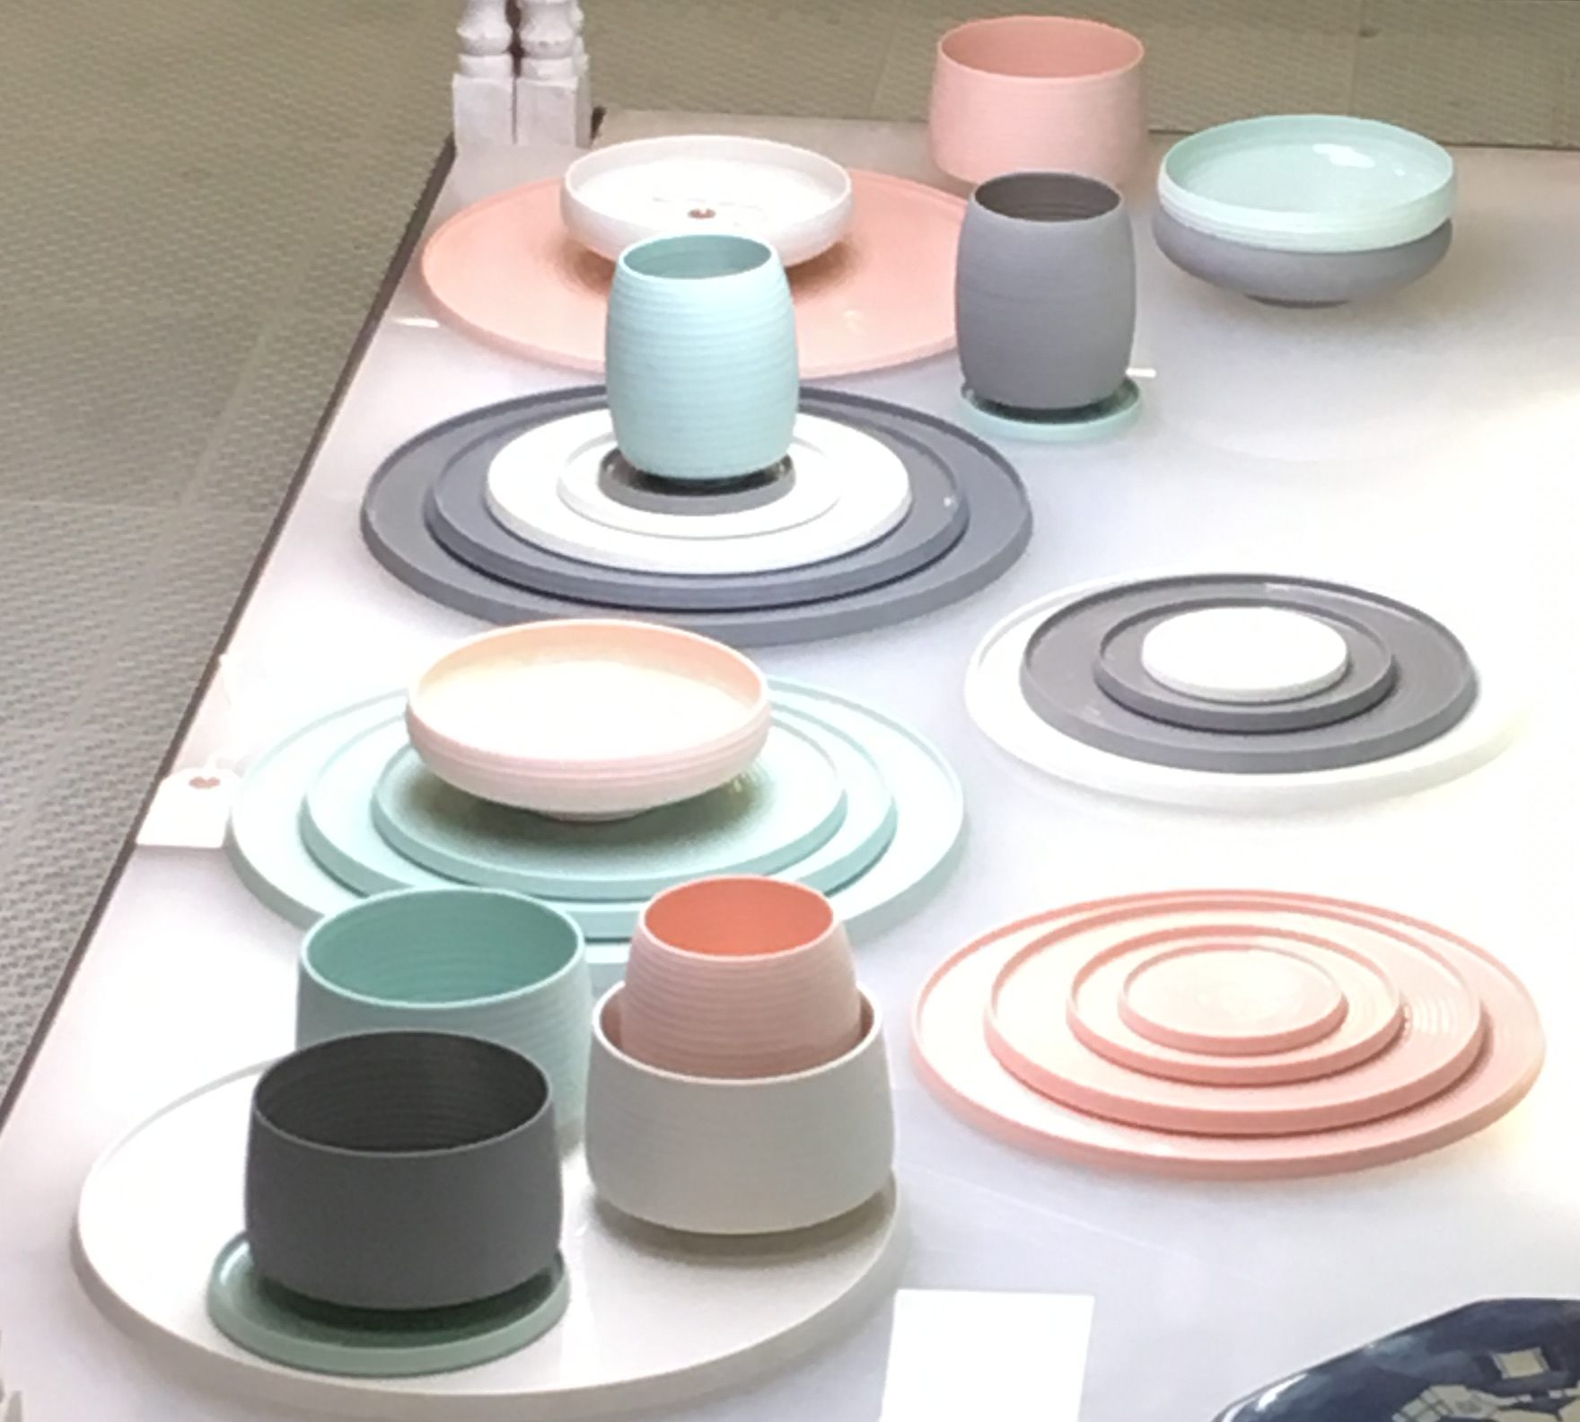
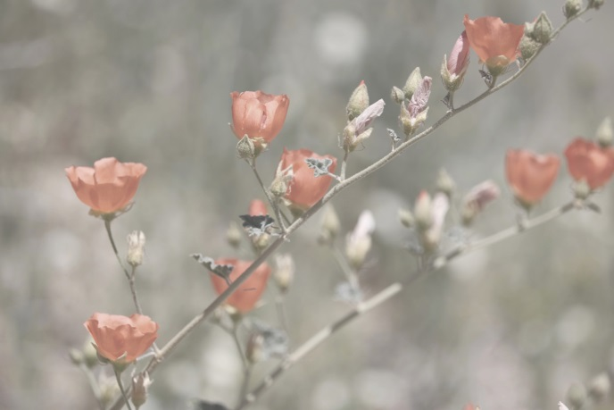
2
COLOR APPLICATIONS WORKSHOP
2018+ WORLD COLORS
Both color and texture work together to exude a sense of comfort. Some surfaces have just a hint of sheen coming through and pairs well with metallic accents within a space.
We see these colors used primarily in upholstery, accessories, and wall paint as a way to use color but make it softer and more approachable. It can be rendered with a matte finish or with a hint of sheen.
Photo on left from CMG member Richard Capel
Photo above from CMG member Karin Jeske

Slide 8
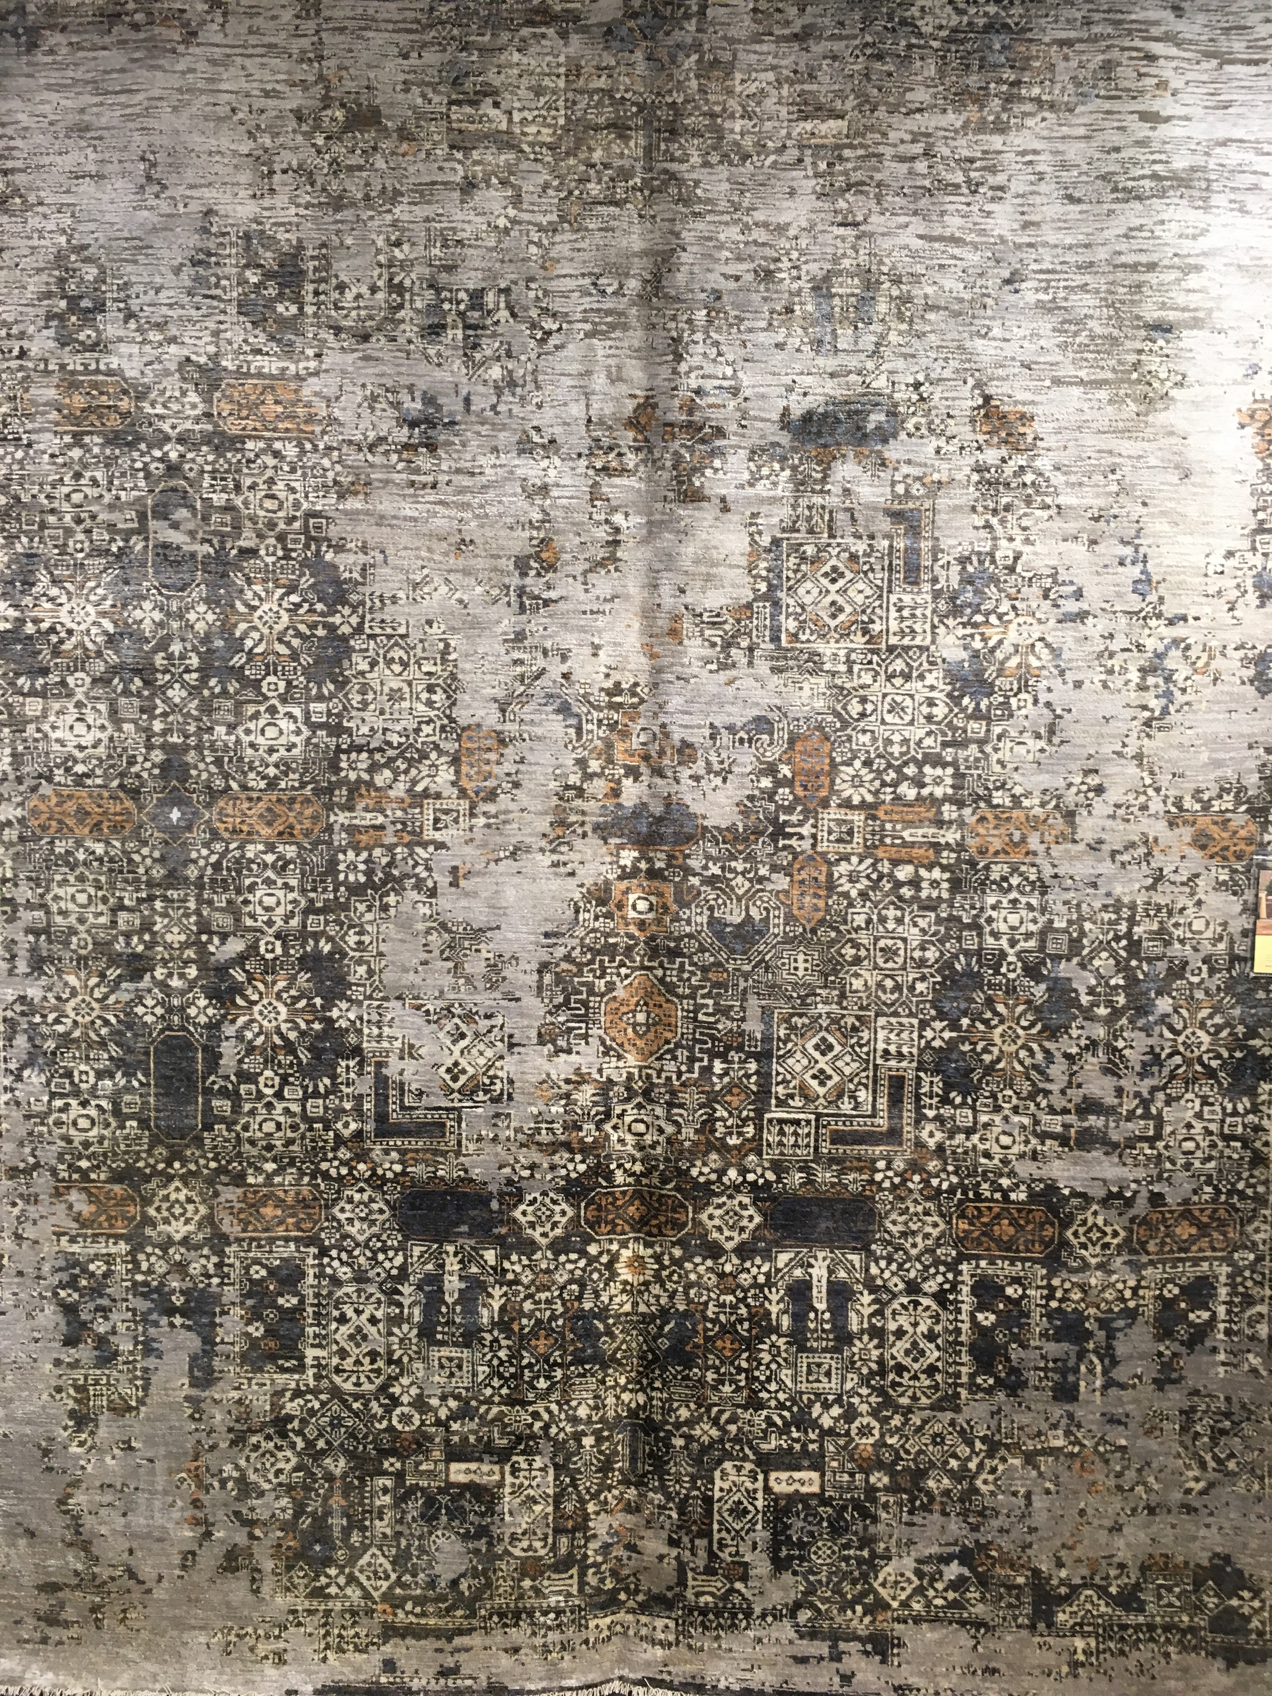
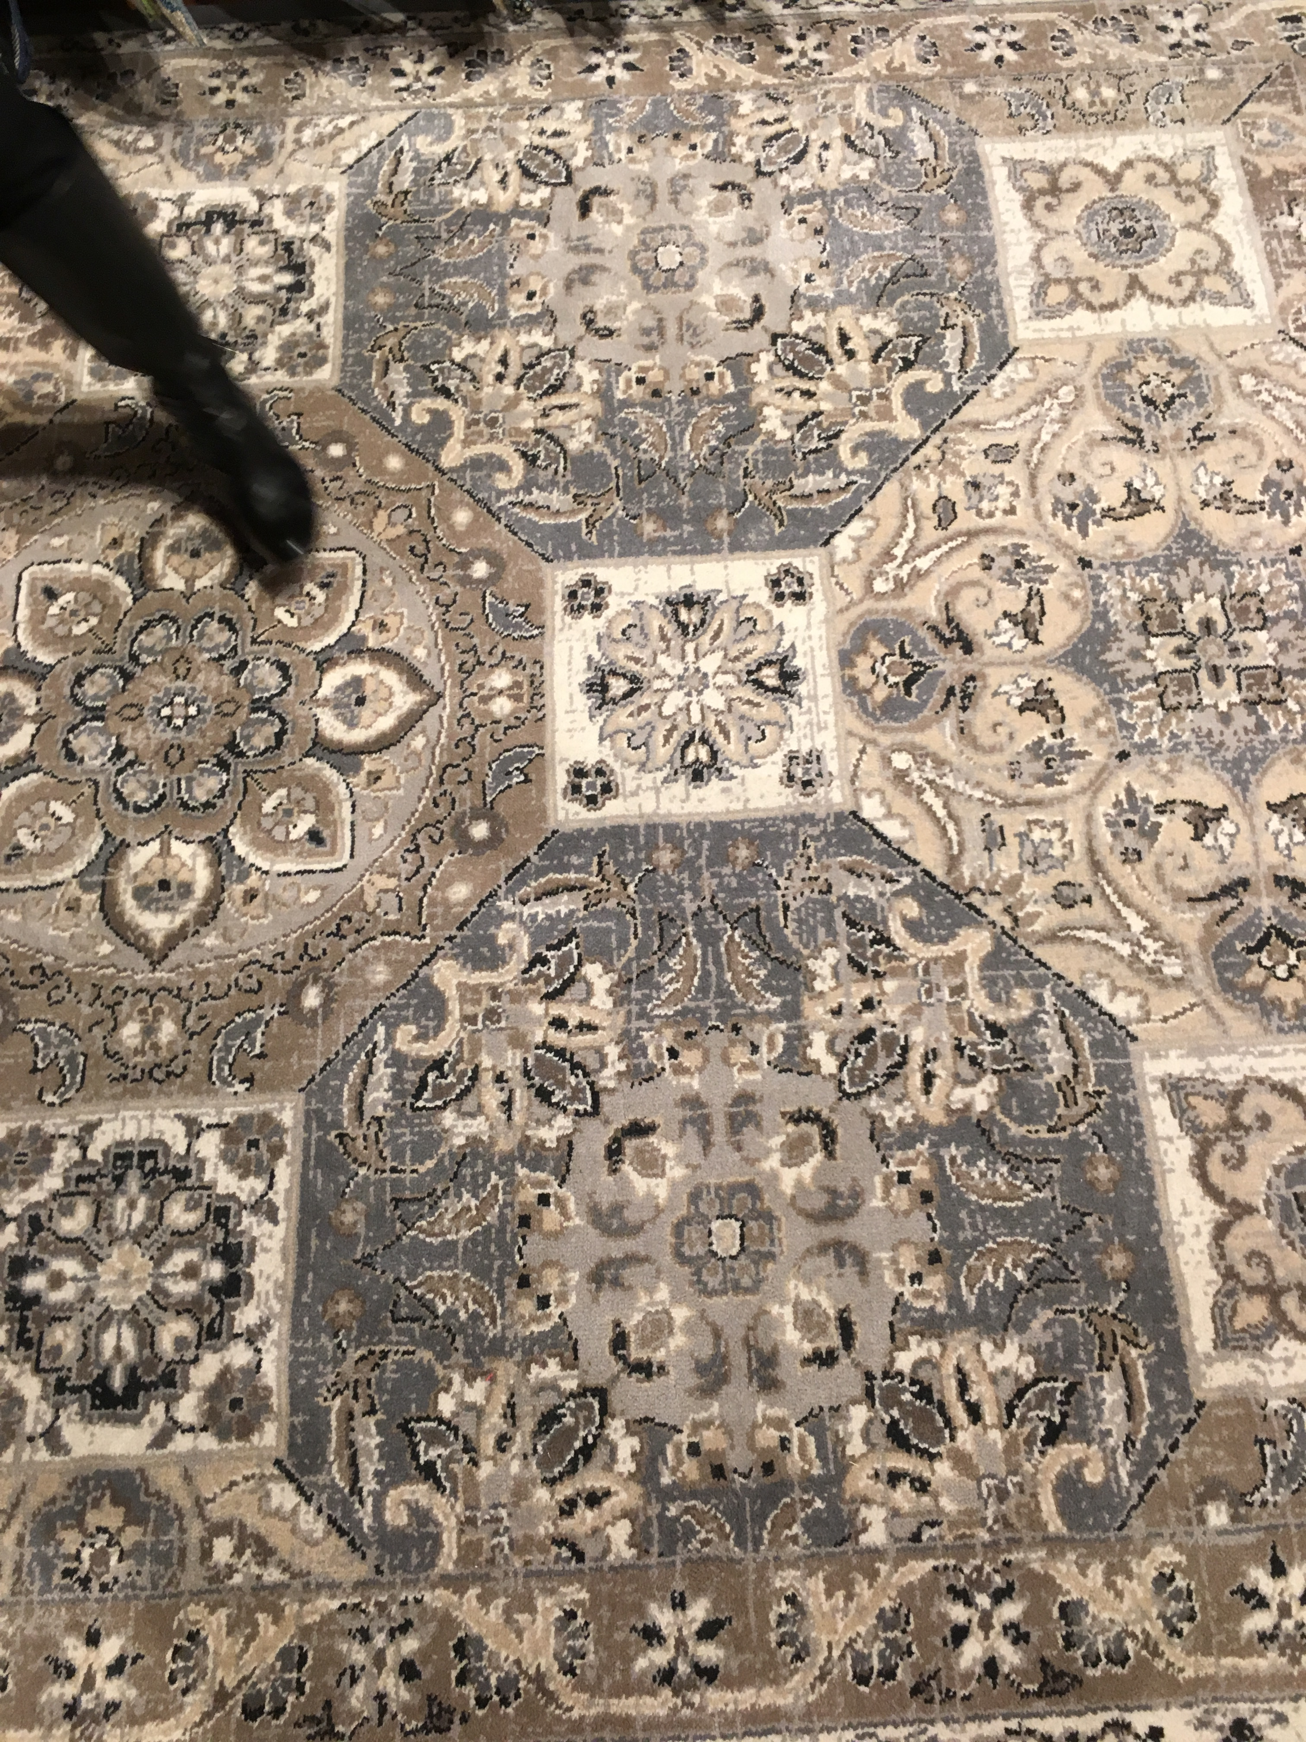
3
COLOR APPLICATIONS WORKSHOP
2018+ WORLD COLORS
2018+ Trend Story #1: Distressed Neutrals
The home furnishings industry has always embraced neutrals as important base colors around which a room’s color palette can be designed. These colors are grounded and reassuring, creating calming and centering experiences that are in contrast with the technology that is an inescapable part of modern life.
Photos from
CMG member Richard Capel

Slide 9
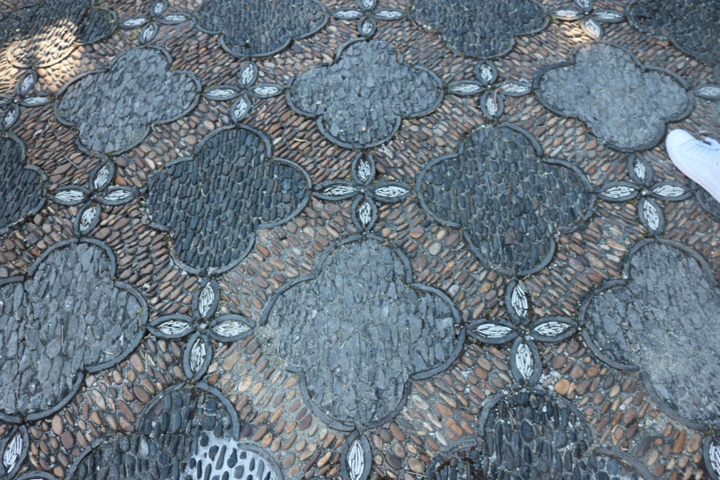
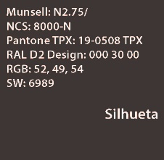
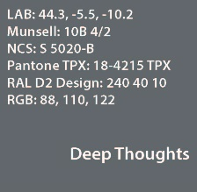
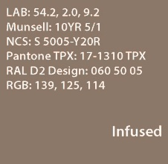
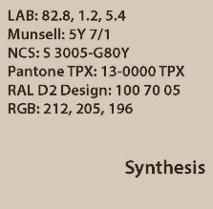
3
COLOR APPLICATIONS WORKSHOP
2018+ WORLD COLORS
Photo from CMG member Karin Jeske
How are the supporting colors you selected manifesting themselves in your industry?
Blue is a new neutral and universally accepted in a broad range of shades. Grayed Blue has become a basic, classic, legacy color. This greyed version is appropriate for the earth-toned palette because it is a color that you would find in nature along with soil and putty.
What other markets /industries /segments are supporting these colors?
Flooring, Window Coverings, Home Furnishings, Contract, and Apparel.

Slide 10
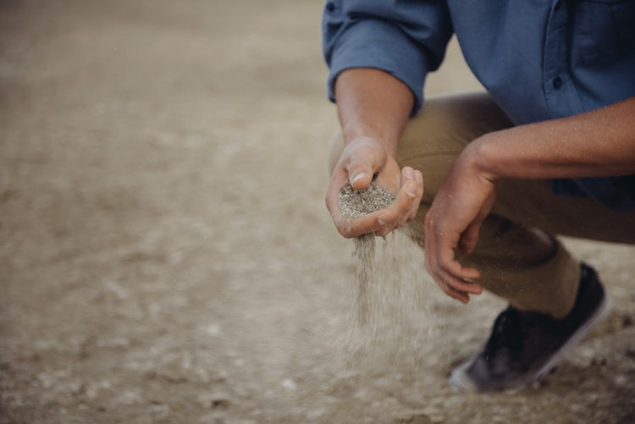
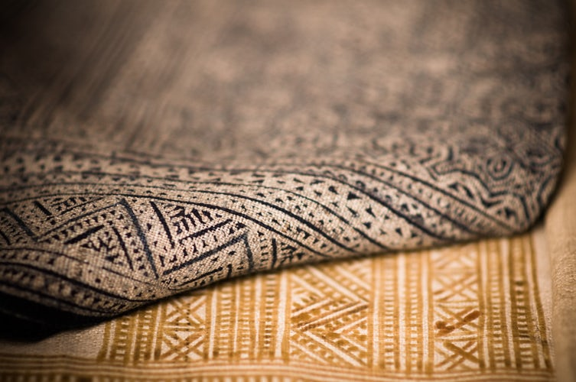
3
COLOR APPLICATIONS WORKSHOP
2018+ WORLD COLORS
The distressed neutrals represent varied tones of color because distressed color doesn’t exist as a pure color. The technique of distressing (whether through weaving or distressing finishes), creates a neutral that is more interesting and complex. Distressing brings multiple colors into the finish through the use of texture and different levels of sheen. It adds interest while maintaining its neutral tone, creating variety within the palette and providing more surface interest.
Photos from Unsplash.com

Slide 11
COLOR APPLICATIONS WORKSHOP
2018+ WORLD COLORS
Please list sources of all imagery included in the report back
Trend Story #1:
Image #1 -
Image #2 –
Image #3 –
Image #4 –
Image #5 –
Image #6 –
Image #7
Trend Story #2:
Image #1 -
Image #2 -
Image #3 –
Image #4 –
Image #5 –
Image #6 –
Image #7 -

Slide 12
COLOR APPLICATIONS WORKSHOP
2018+ WORLD COLORS
Please list sources of all imagery included in the report back
Trend Story #3:
Image #1 -
Image #2 -
Image #3 –
Image #4 –
Image #5 –
Image #6 –
Image #7 -

